Slide 1

Time Series
Presented By-
Kunal Bharadwaj
D19016

Slide 2
What is Prophet?
Prophet is an open source library published by Facebook that is based on decomposable (trend+seasonality+holidays) models.
In 2017, Facebook open sourced the prophet model which was capable of modelling the time series with strong multiple seasonality at day level, week level, year level etc. and trend
It provides us with the ability to make time series predictions with good accuracy using simple intuitive parameters and has support for including impact of custom seasonality and holidays!(Ex: Diwali, Super Bowl)

Slide 3
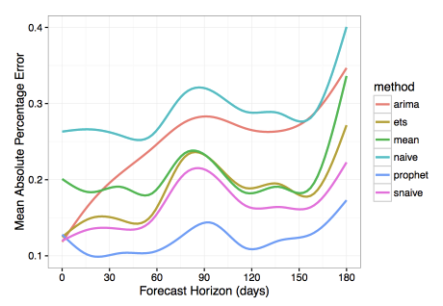
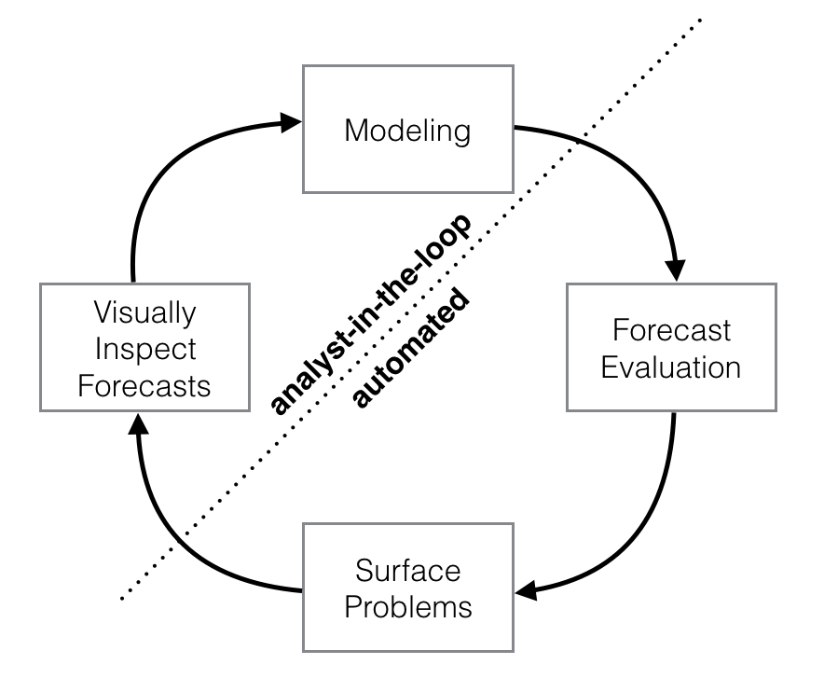
Why Prophet?
Prophet makes it much more straightforward to create a reasonable, accurate forecast.
Prophet forecasts are customizable in ways that are intuitive to non-experts.
Prophet has shown substantially lower forecasting error than the other models

Slide 4
Where Prophet shines
hourly, daily, or weekly observations with at least a few months (preferably a year) of history
strong multiple “human-scale” seasonality: day of week and time of year
important holidays that occur at irregular intervals that are known in advance (e.g. the Super Bowl, Black Friday, Diwali)
a reasonable number of missing observations or large outliers
historical trend changes, for instance due to product launches or logging changes
trends that are non-linear growth curves, where a trend hits a natural limit or saturates

Slide 5

The Prophet Forecasting Model
g(t): piecewise linear or logistic growth curve for modelling non-periodic changes in time series
s(t): periodic changes (e.g. weekly/yearly seasonality)
h(t): effects of holidays (user provided) with irregular schedules
ε_{t}: error term accounts for any unusual changes not accommodated by the model

Slide 6
Trend
The Prophet library implements two possible trend models for g(t) .The first one is called Nonlinear, Saturating Growth. It is represented in the form of the logistic growth model:
g(t)=C/1+exp(−k(t−m)),
where:
C is the carrying capacity (that is the curve's maximum value).
k is the growth rate (which represents "the steepness" of the curve).
m is an offset parameter.
This logistic equation allows modelling non-linear growth with saturation, that is when the growth rate of a value decreases with its growth. One of the typical examples would be representing the growth of the audience of an application or a website. Actually, C and k are not necessarily constants and may vary over time. Prophet supports both automatic and manual tuning of their variability. The library can itself choose optimal points of trend changes by fitting the supplied historical data.
Also, Prophet allows analysts to manually set changepoints of the growth rate and capacity values at different points in time. For instance, analysts may have insights about dates of past releases that prominently influenced some key product indicators.
The second trend model is a simple Piecewise Linear Model with a constant rate of growth. It is best suited for problems without saturating growth.

Slide 7
Seasonality
The seasonal component s(t) provides a flexible model of periodic changes due to weekly and yearly seasonality.
Weekly seasonal data is modeled with dummy variables. Six new variables are added: monday, tuesday, wednesday, thursday, friday, saturday, which take values 0 or 1 depending on the day of the week. The feature sunday is not added because it would be a linear combination of the other days of the week, and this fact would have an adverse effect on the model.
Yearly seasonality model in Prophet relies on Fourier series.
Holidays and Events
The component h(t) represents predictable abnormal days of the year including those on irregular schedules, e.g., Black Fridays.
To utilize this feature, the analyst needs to provide a custom list of events.

Slide 8
Installation in Windows
1)First install Anaconda or miniconda in your Windows machine and add conda python path to env variable as default python.
2)Open your command prompt and run following commands.
On Prompt install Ephem:
conda install -c anaconda ephem
Install Pystan:
conda install -c conda-forge pystan
Finally install Fbprophet
conda install -c conda-forge fbprophet
https://stackoverflow.com/questions/53178281/installing-fbprophet-python-on-windows-10

Slide 9
Parameters in Prophet
Trend parameters
Parameter Description
growth linear’ or ‘logistic’ to specify a linear or logistic trend
changepoints List of dates at which to include potential changepoints (automatic if not specified)
n_changepoints If changepoints in not supplied, you may provide the number of changepoints to be automatically included
changepoint_prior_scale Parameter for changing flexibility of automatic changepoint selection
Seasonality & Holiday Parameters
Parameter Description
yearly_seasonality Fit yearly seasonality
weekly_seasonality Fit weekly seasonality
daily_seasonality Fit daily seasonality
holidays Feed dataframe containing holiday name and date
seasonality_prior_scale Parameter for changing strength of seasonality model
holiday_prior_scale Parameter for changing strength of holiday model

Slide 10
Advantages:
Open Source
Accurate and fast
Allows for a large number of people to make forecasts, possibly without training in time series methods;
Tunable parameters
Available for both Python and R

Slide 11
Does it have any limitations?
Even though Prophet offers an automated solution for ARIMA, this methodology is under development and not completely stable.
In case your time-series is highly irregular, let’s say you have quarterly as well as bi-weekly seasonality, it will be hard for prophet to account for that. In such cases, even your traditional time-series model will have hard time forecasting until you manually tune each parameter.
Multiplicative models cannot be accounted for using prophet.
Data need to be feed in pre-defined format.

Slide 12
https://facebook.github.io/prophet/
https://pbpython.com/prophet-overview.html
https://towardsdatascience.com/time-series-forecasting-with-prophet-54f2ac5e722e
https://towardsdatascience.com/a-quick-start-of-time-series-forecasting-with-a-practical-example-using-fb-prophet-31c4447a2274
https://www.analyticsvidhya.com/blog/2018/05/generate-accurate-forecasts-facebook-prophet-python-r/

